Slide 1





Evaluating the Oura Ring for Fertility Tracking:
A Comparison between
a Smart Ring and a Vaginal Sensor
1 in 6
1 in 10
couples experience infertility at one point in their lives globally (WHO, 2023)
people are diagnosed with PCOS globally
(WHO, 2023)
1 in 4
1 in 10
infertile couples are diagnosed with unexplained infertility (UK) (NHS, 2023)
people are diagnosed with endometriosis globally
(WHO, 2023)
Sarah Koerner, PhD Candidate
Supervisors: Dr Louise Millard &
Prof Tom Gaunt
University of Bristol
Project funding: University of Bristol Jean Goulding Institute Seed Corn Award.
Contact: sarah.koerner@bristol.ac.uk

Slide 2
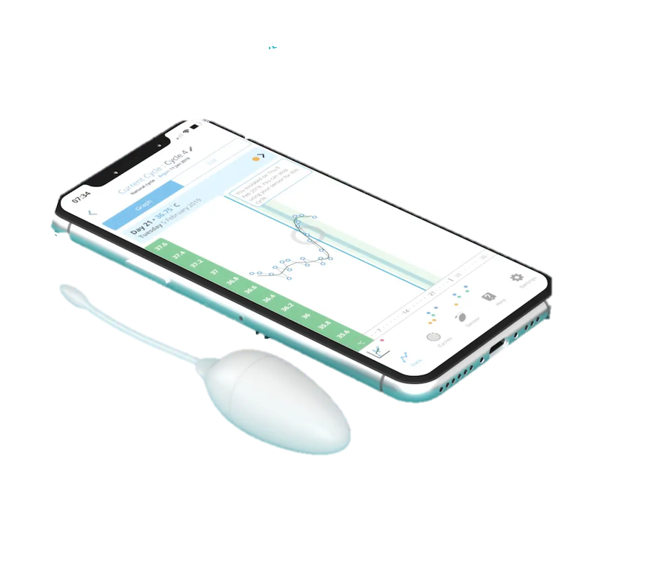
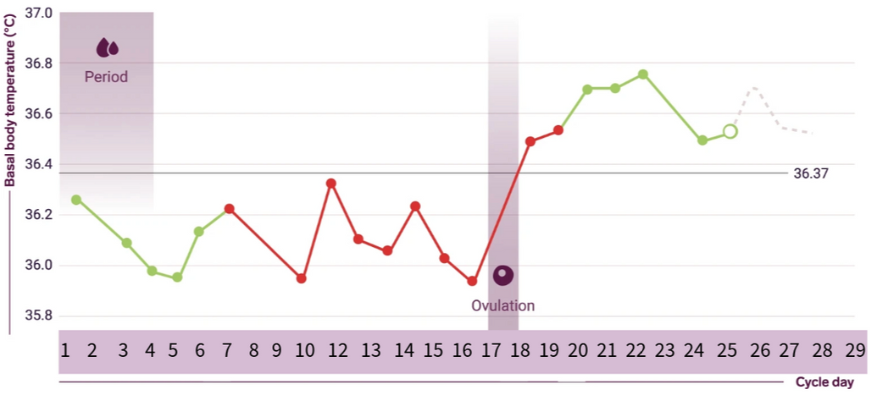
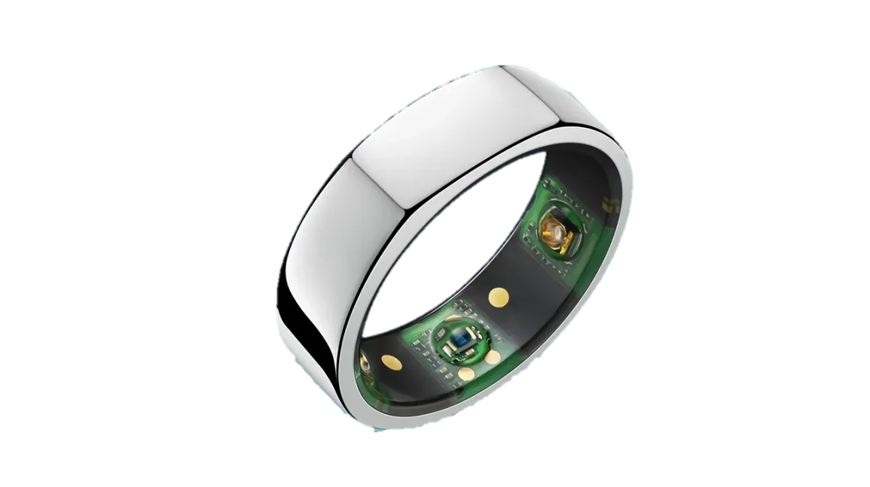
Body Temperature as a Key Fertility Marker
OvuSense (OvuCore)
by viO HealthTech
Bull et al. (2019)
Oura Ring Gen 3
by Oura Health Oy
Contact: sarah.koerner@bristol.ac.uk

Slide 3



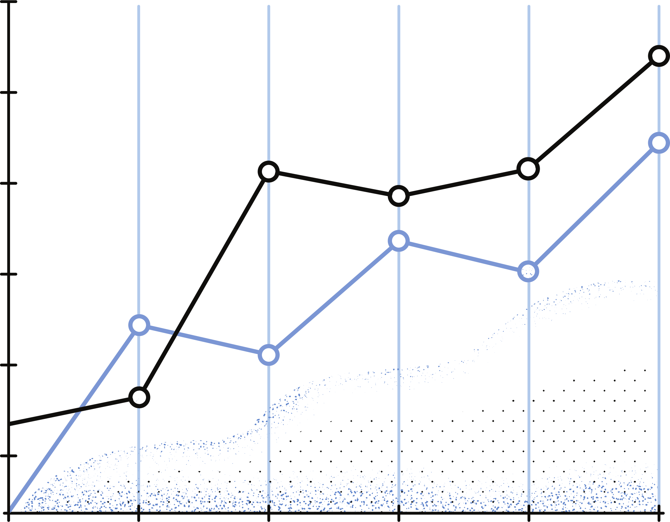
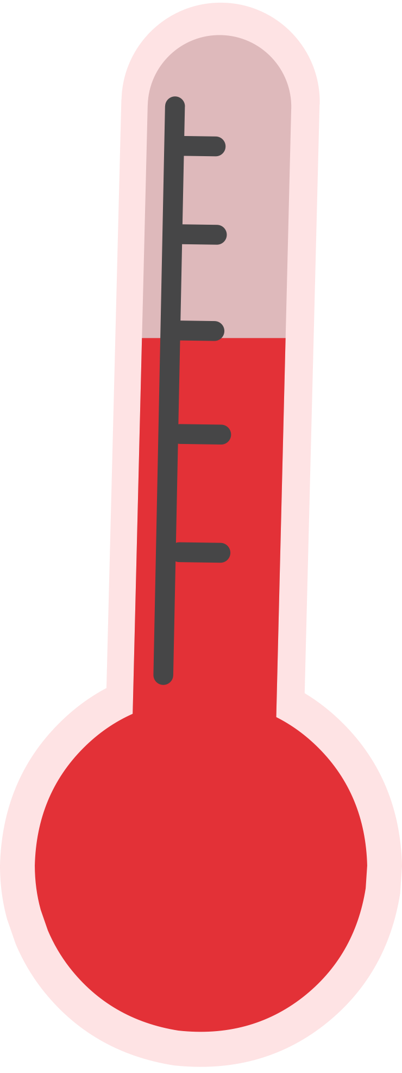
Study Aims & Methods
Set up devices
40 nights
Data analysis
Baseline
Questionnaire
User feedback
Questionnaire
Aim 1: Compare temperature data – vaginal (OvuSense) vs finger (Oura)
Aim 2: Evaluate participant acceptability (questionnaire + temperature data completeness)
Contact: sarah.koerner@bristol.ac.uk

